Slide 1

Data Science Academic E-Portfolio
Olugbenga Asaolu

Slide 2

Problem & Opportunity
Recent upskilling in Python, R, & GenAI
Training via The GRAPH Network
Need to showcase new competencies
Notes:
“Over the last few months, I’ve immersed myself in advanced data-science and generative-AI tools—Python, R, Cursor.ai, Julius, prompt engineering, and GenAI—through platforms like The GRAPH Network, Accelebrate, and LinkedIn Learning. While these trainings have equipped me with cutting-edge skills, there’s currently no single, cohesive way to demonstrate my capabilities to hiring managers. That’s the problem—and the opportunity—for an Academic E-Portfolio.” Visual Suggestion: – Icon of a graduation cap overlaid with AI circuit lines or placeholder screenshot of training certificates

Slide 3
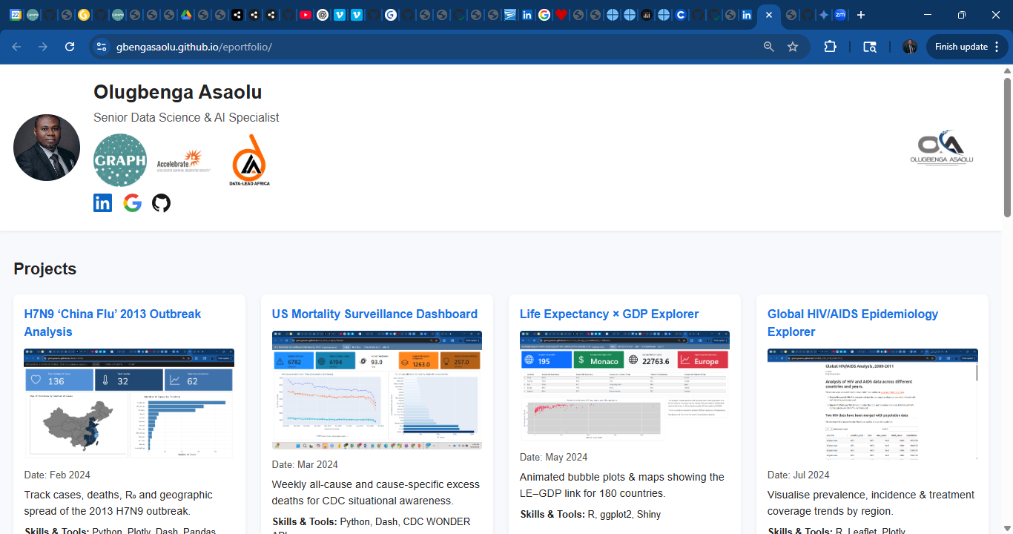
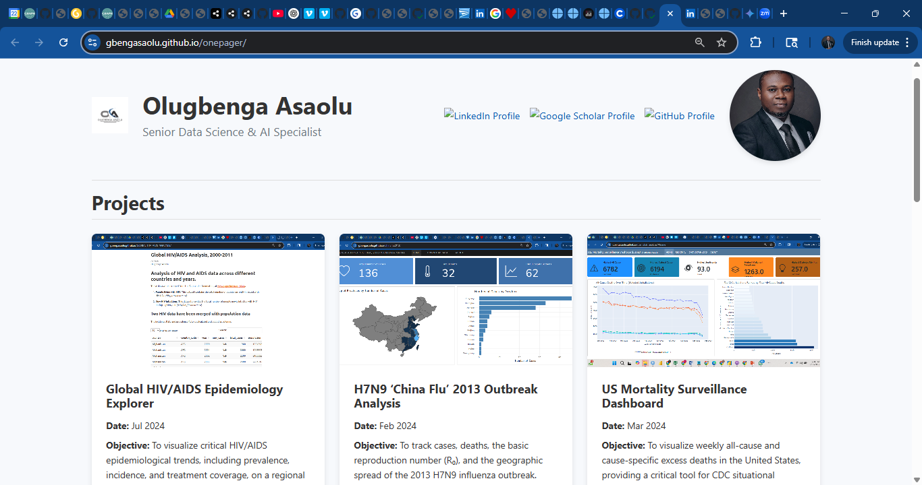
Solution & Workflow 1/2
https://gbengasaolu.github.io/eportfolio/
https://gbengasaolu.github.io/onepager/
Notes:
“My solution is a streamlined, one-page Academic E-Portfolio. First, visitors land on a clean project gallery. Next, they can expand code-snippet panels for Python and R examples. Finally, a live embed—shown here as a demo placeholder—runs sample Cursor.ai and Julius workflows directly in the browser. Under the hood, I used ChatGPT-3 to generate the initial HTML, then deployed it seamlessly to GitHub Pages.” Visual Suggestion: – Workflow diagram icon or [Demo video placeholder: “Click to play”]

Slide 4
Solution & Workflow
Drafted my zero prompt
Used ChatGPT 4.0 for prompt engineering
Applied the refined prompt to generate html code
Published on GitHub
Used Gemini 2.5 Pro to further refine prompts a few times
Final publication on GitHub

Slide 5
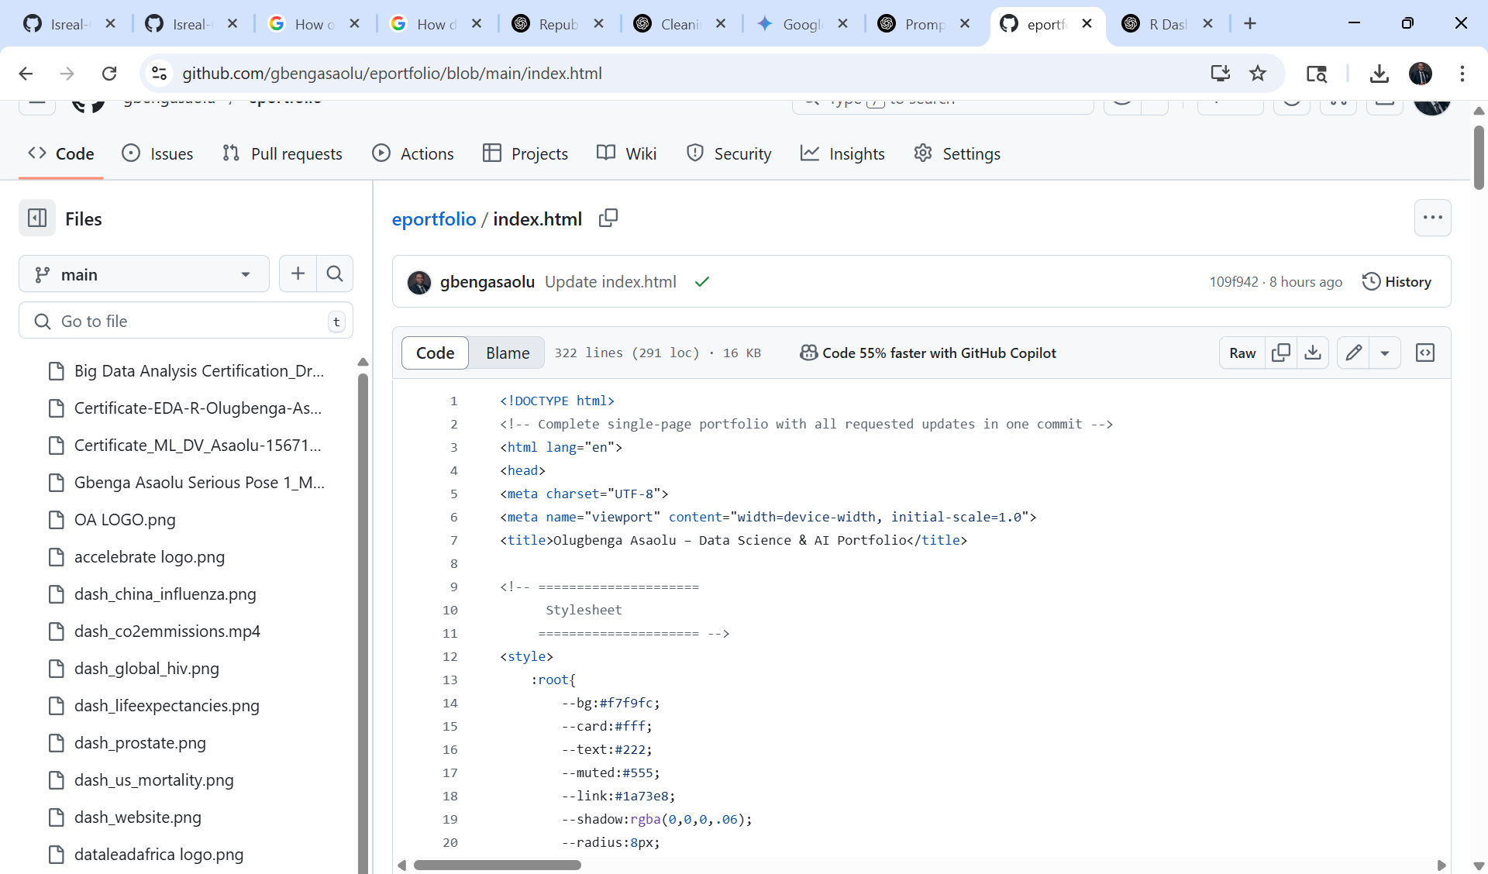
Final Product 1: HTML Code
https://gbengasaolu.github.io/eportfolio/
Notes:
“My solution is a streamlined, one-page Academic E-Portfolio. First, visitors land on a clean project gallery. Next, they can expand code-snippet panels for Python and R examples. Finally, a live embed—shown here as a demo placeholder—runs sample Cursor.ai and Julius workflows directly in the browser. Under the hood, I used ChatGPT-3 to generate the initial HTML, then deployed it seamlessly to GitHub Pages.” Visual Suggestion: – Workflow diagram icon or [Demo video placeholder: “Click to play”]

Slide 6
Final Product 1: E-Portfolio (ChatGPT)
https://gbengasaolu.github.io/eportfolio/
Notes:
“My solution is a streamlined, one-page Academic E-Portfolio. First, visitors land on a clean project gallery. Next, they can expand code-snippet panels for Python and R examples. Finally, a live embed—shown here as a demo placeholder—runs sample Cursor.ai and Julius workflows directly in the browser. Under the hood, I used ChatGPT-3 to generate the initial HTML, then deployed it seamlessly to GitHub Pages.” Visual Suggestion: – Workflow diagram icon or [Demo video placeholder: “Click to play”]

Slide 7
Final Product 2: E-Portfolio (Gemini)
Notes:
“My solution is a streamlined, one-page Academic E-Portfolio. First, visitors land on a clean project gallery. Next, they can expand code-snippet panels for Python and R examples. Finally, a live embed—shown here as a demo placeholder—runs sample Cursor.ai and Julius workflows directly in the browser. Under the hood, I used ChatGPT-3 to generate the initial HTML, then deployed it seamlessly to GitHub Pages.” Visual Suggestion: – Workflow diagram icon or [Demo video placeholder: “Click to play”]

Slide 8
Key Features & AI Tools
Core Features:
Interactive project gallery
Expandable code panels
Live link
AI Tools:
ChatGPT-3.0 mini
Gemini 2.5 Pro
GitHub Pages hosting
Gamma for ppt
Notes:
“Key features include an interactive project gallery, expandable code-snippet panels, and a live-link demo embed—all on a single page. I leveraged ChatGPT-3 for rapid HTML generation and deployed via GitHub Pages to ensure continuous availability and version control.”
Visual Suggestion: – Icon grid showing “Gallery”, “Code”, “Demo” or logo icons of ChatGPT and GitHub

Slide 9

Current Model Limitations
Browsers Styling inconsistencies
Accessibility gaps (ARIA labels, keyboard nav)
Limited customizations options
Notes:
“Despite rapid code generation, GenAI-produced HTML can lack styling consistency across different browsers, miss accessibility features like ARIA labels and keyboard navigation, and require manual overrides to match brand guidelines.”
Visual Suggestion: – Warning triangle over code snippet or accessibility icon

Slide 10
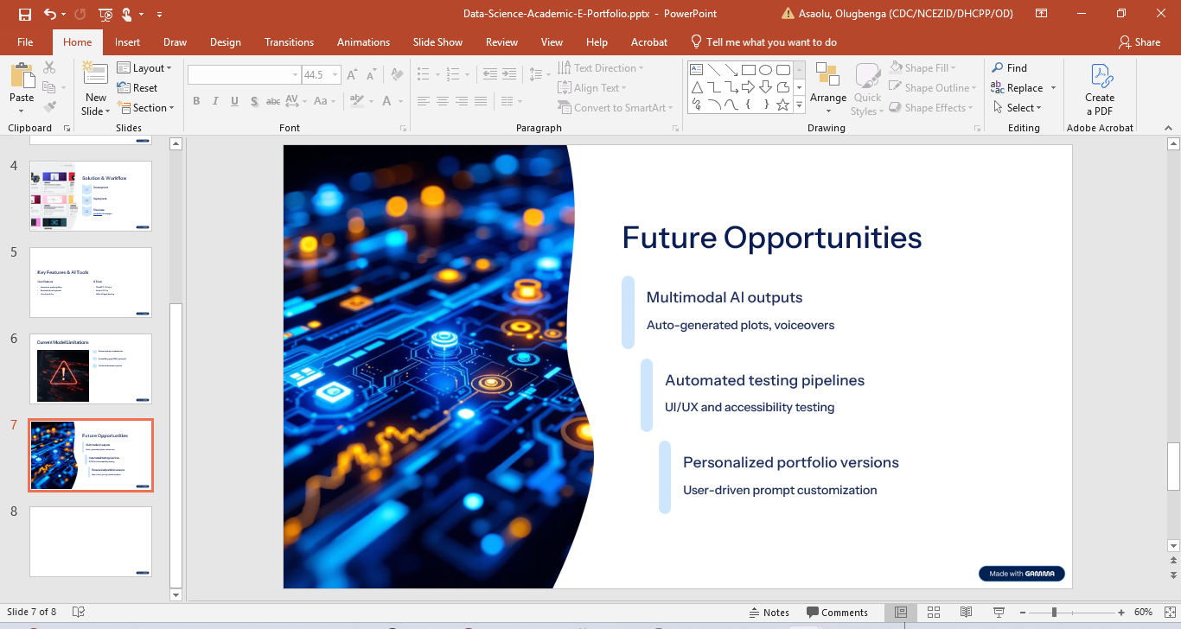

Future Opportunities
Integrate multimodal AI outputs (auto-generated plots, voiceovers)
Automated testing pipelines for UI/UX and accessibility
Personalized portfolio versions via user-driven prompts
Notes:
“Looking ahead, emerging AI can auto-generate visualizations and voiceovers for each project, integrate automated UI and accessibility testing, and even personalize portfolio content on demand through user-driven prompts—transforming a static showcase into a dynamic experience.”
Visual Suggestion: – Futuristic AI icon or roadmap graphic pointing to “Next-Gen AI”

Slide 11
Thank you

